Slide 1

Supply Chain Management and Logistics
- by
Dharshini V (412620243007)
Arisun A (412620243002)
Pranesh Arjun R (412620243017)
Notes:
To change the image on this slide, select the picture and delete it. Then click the Pictures icon in the placeholder to insert your own image.

Slide 2
Contents
Introduction
Supply Chain Management
SCM Decision phases
Logistics & IT
Forecasting
Dataset

Slide 3
Introduction
SCM
SCM Introduction
SCM Process flow
SCM Implementation steps
Goals
Supply Chain components

Slide 4
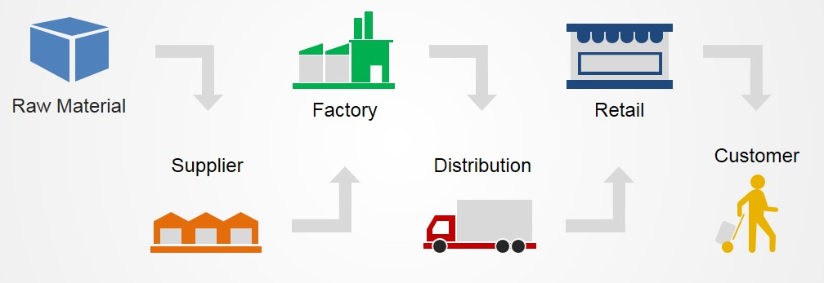
Supply Chain Management
It is the management of flow of products and services, which begins from the origin of products and ends at the product’s consumption
It also comprises movement and storage of raw materials that are involved in work in progress, inventory and fully furnished goods.

Slide 5
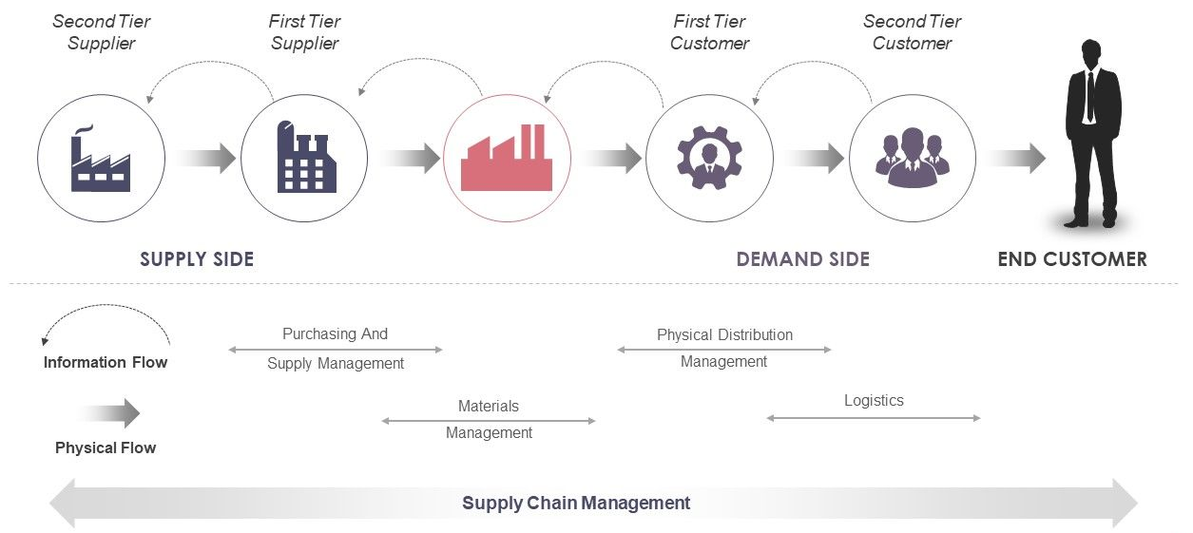
SCM Introduction

Slide 6
Components
Components of SCM
Strategic Planning
Sourcing
Customer Demand
Inventory Management
Production
Warehousing
Transportation
Return of goods

Slide 7
Process Flow
Plan
Source
Return
Execute
Deliver

Slide 8
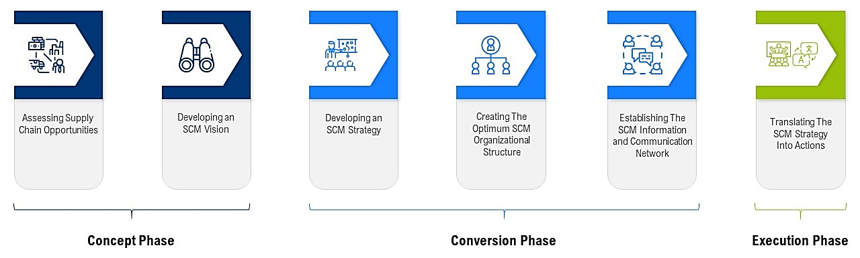
Implementation steps

Slide 9
Goals
Minimization of supply chain expenses is very essential
Increase expectations of clients for higher product variety, customized goals, off-season availability of inventory and rapid fulfillment should be matched
To maximize resource productivity, construct standardized processes, remove duplicate efforts and minimize the inventory levels
Cost efficient and cheap products are necessary, but supply chain managers need to concentrate on value creation for their customers
To leverage inventory as shared resource and utilize the distributed order management technology to complete orders from optimal node in the supply chain.

Slide 10
Decision phases
SCM
Decision Phases
Supply chain planning
Supply chain strategy
Supply chain operational

Slide 11
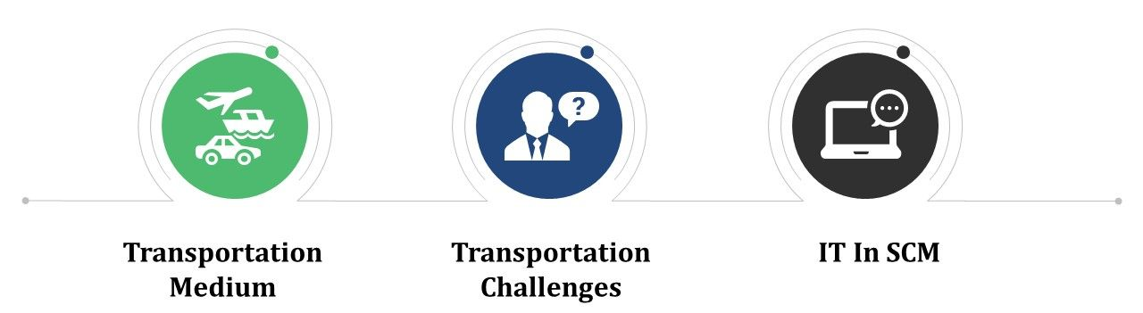
Logistics & IT

Slide 12
Transportation Medium
Plane
Truck
Rail
Ship
Electronic

Slide 13
Transportation challenges
Challenges
Economic Uncertainty
Labor Laws
Customer’s Expectation
Globalization
Improvised technologies
Changing transportation industry
Varying fuel prices

Slide 14
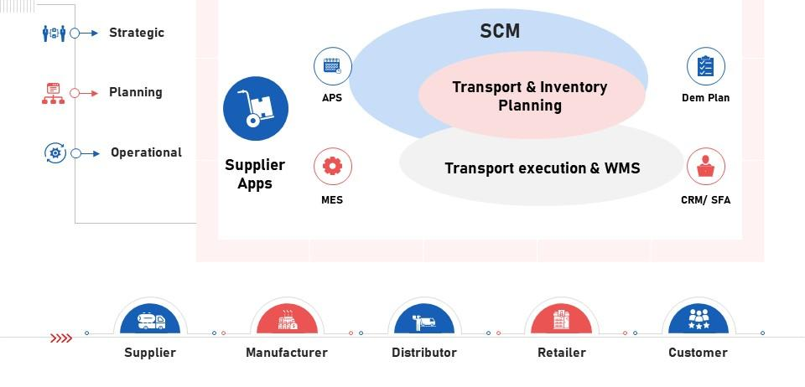
IT in SCM

Slide 15
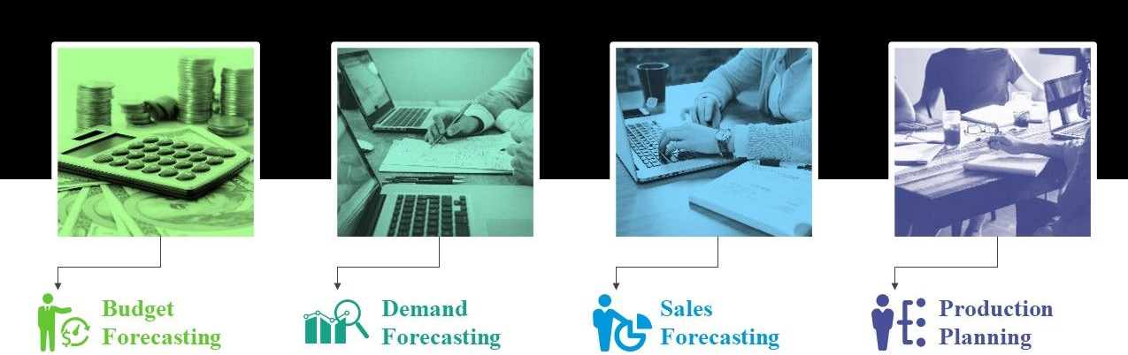
Forecasting

Slide 16
Dataset

Slide 17
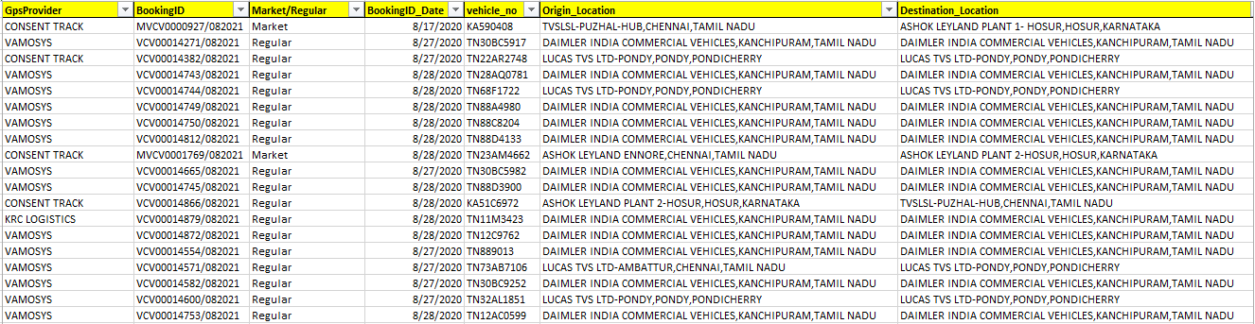
Dataset
Dataset Link:
https://www.kaggle.com/datasets/ramakrishnanthiyagu/delivery-truck-trips-data?resource=download

Slide 18
Dataset description
GpsProvider - Vendor who provides GPS
Booking ID - Unique Identification for a trip
Market/Regular - Type of trip.
BookingID_Date - Date when booking was created
vehicle no - Truck Number
Origin Location - Trip start place
Destination Location - Trip end place
Org_lat_lon - Latitude/Longitude of start place

Slide 19
Dataset description
GpsProvider - Vendor who provides GPS
Booking ID - Unique Identification for a trip
Market/Regular - Type of trip.
BookingID_Date - Date when booking was created
vehicle no - Truck Number
Origin Location - Trip start place
Destination Location - Trip end place
Org_lat_lon - Latitude/Longitude of start place

Slide 20
Dataset description
Planned_ETA - Planned Estimated Time of Arrival
Current Location - Live location
Destination Location - Repeat of destination location
actual_eta - Time when the truck arrived
Curr_lat - changes each time when we receive GPS ping
Curr_lon - changes each time when we receive GPS ping
on time - If the truck arrived on time
delay - If the truck arrived with a delay

Slide 21
Dataset description
trip_start_date - Date/Time when trip started
trip_end_date Date/Time when trip ended - based on documentation
TRANSPORTATION_DISTANCE_IN_KM - Total KM of travel
vehicleType - Type of Truck
Minimum_kms_to_be_covered_in_a_day - Minimum KM the driver needs to cover in a day
Driver_Name - Driver details
Driver_MobileNo - Driver details
customer ID - Customer details

Slide 22
Dataset description
DestinationLocation_Code - Destination code
supplierNameCode - Supplier - Who provides the vehicle
customerNameCode - Customer details
supplier ID - Supplier - Who provides the vehicle
Des_lat_lon - Latitude/Longitude of end place
Data_Ping_time - Time when we receive GPS ping
OriginLocation_Code - Origin code

Slide 23
Thank you
Any Queries…

